Slide 1

International institute of professional studies,DAVV INDORE
Online Student Registration System
Submitted by :-
Vikas Kaushal
Roll_No.: IT-2K19-71
MTECH-IT

Slide 2
A PROJECT REPORT ON ONLINE STUDENT REGISTRATION SYSTEM
Software Project Management Plan
1. Purpose
2. Objective
3. Project scope
4. Technologies

Slide 3
1. Pupose
We can see now a days during covid-19 the student is not able to register and filled application form to the college offline. Proposed online student registration system will eliminate all the manual intervention and increase the speed of whole process. System will allow student to fill the form online, system has inbuilt validation system to validate the entered data. After successful submission, system will give unique registration no for each student. Student can login into system by using registration no and give online test. System will show the result after instantly and stored the results for further use.

Slide 4
2. Objective
Online Student Registration System –is complete end to end solution to cover all aspects of online student registration process.
The basic objective of developing this project is:
•Provides complete web site solution, including student registration, giving tests, storing of results. Complete web based administration.
•The online examination system can automatically add the marks allocated in each question to determine the total mark for the test.
•Using this feature the questions can be selected from the question Bank, and also the appearance of questions in the Random Order.
•Student can registered and login into the system.
•Can view test result and give online test.
•Student must able to change his/ her own password.
•Complete web based system no installation required to run the application in client system.
•student result must save and can be retrieving later on.
•Question must provide answer type like multiple right answer selection and one right answer selection. Test screen must provide options accordingly.
•System must able to evaluate the examination and display the result instantly, student must view the correct answer after complete the test.
•System has powerful logical access management in place, each user must be identified by login id and strict password policy is applied to secure the system.
•Generate various reports for administration like, Total students/members registered for examination, no of available examination, test given by the student.

Slide 5
3.Project Scope
Online Student Registration System will permit to register and take online examination and maintaining master information and generating various reports of test. The main users of the project are Student or Member and system Administrator.From an end-user perspective, the Online Student Registration System Project consists of following functional elements: enhanced student registration module, giving examination, manage password.

Slide 6
4.Technologies
The online student registration system web application will operate with the following Web Browsers: Microsoft Internet Explorer version 5.0, 6.0. 7.0
Software requirements: MS Access, ASP.
Hard disc- nGB depending upon the requirement to store data minimum of 25GB.
Hardware equirements: 256(minimum)/512(recommended) MB RAM
The online student registration system web application shall operate on a server running the latest versions of IIS (Internet Information Server).

Slide 7
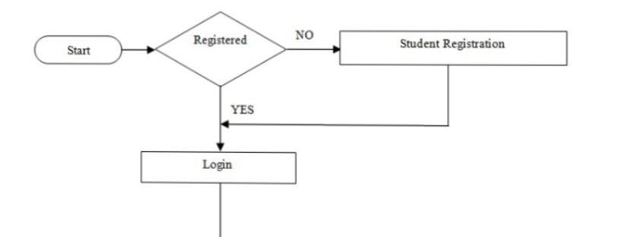
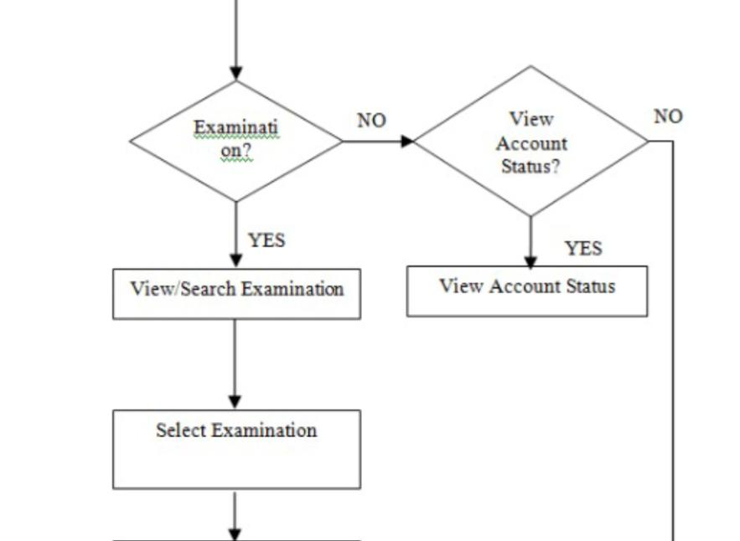
PROCESS FLOW CHART

Slide 8
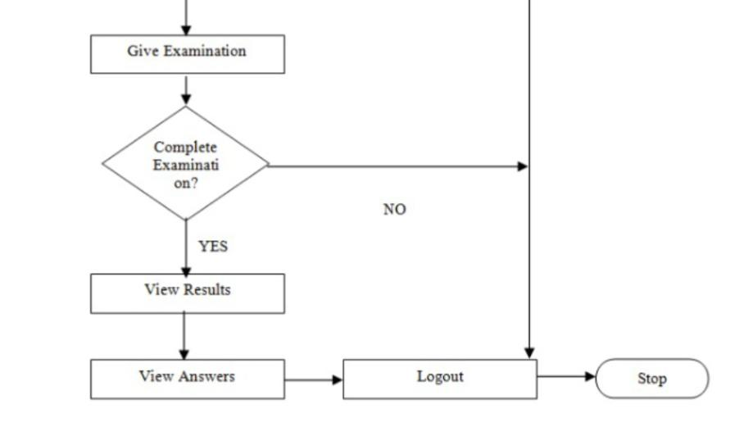

Slide 9
Data Dictionary
Table: answer_master
[answer_master table is used to store multiple answers for every questions]
•Table: test_master
[test_master table is used to store test details]
•Table: registration
[registration table is used to stores student registration details]
•Table: question_master
[Table question_master is used to store question details]

Slide 10
Data Flow Diagram DFD
A data-flow diagram (DFD) is a graphical representation of the "flow" of data through an information system. DFDs can also be used for the visualization of data processing (structured design). On a DFD, data items flow from an external data source or an internal data store to an internal data store or an external data sink, via an internal process.

Slide 11
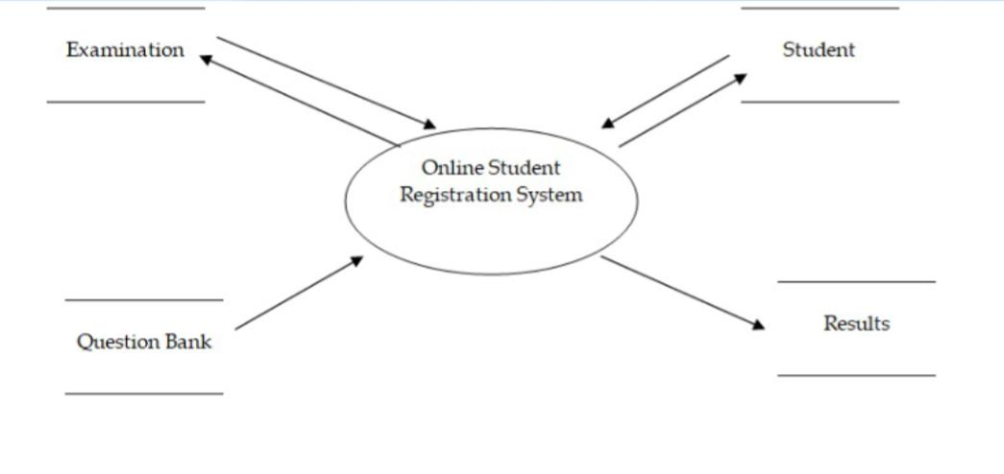
Context Level

Slide 12
Explanation of Context level
This context-level data flow diagram first, which shows the interaction between the system and external agents which act as data sources and data sinks. On the context diagram (also known as the Level 0 DFD) the system's interactions with the outside world are modelled purely in terms of data flows across the system boundary. This context diagram shows the entire Online Student Registration System as a single process.

Slide 13
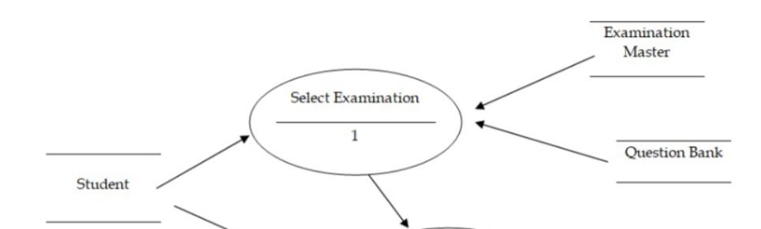
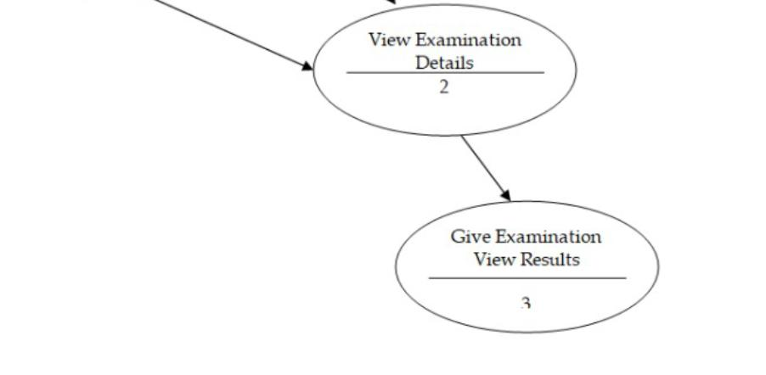
High Level Diagram

Slide 14
Explanation of High Level Diagram
This level shows all processes at the first level of numbering, data stores, external entities and the data flows between them. The purpose of this level is to show the major high-level processes of the Online Student Registration System and their interrelation. A level-1 diagram must be balanced with its parent context level diagram, i.e. there must be the same external entities and the same data flows, these can be broken down to more detail in the level 1, e.g. the "Select Examination" data flow could be spilt into "View Details" and "View Results" and still be valid.

